Slide 1

Netflix Stock Profile- 2017

Slide 2
My Objective-
The following slides will use a series of graphs I have created to break down the performance of Netflix stock over 2017.
Objective -to help provide easy to read visual data that will assist financial analysts assess the risk of Netflix stock based on 2017 performance.
To do this we will examine-
The distribution of Netflix stock prices for the past year
Netflix's earnings and revenue in the last four quarters
The actual vs. estimated earnings per share for the four quarters in 2017
A comparison of the Netflix Stock price vs the Dow Jones Industrial Average price in 2017

Slide 3
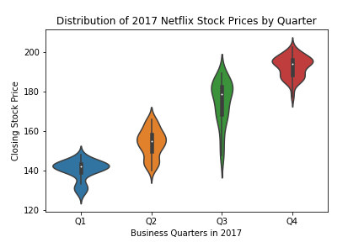
Distribution of Netflix Stock Prices in 2017
Key Points-
Price ranges- Q1= 124.31 - 148.29 Q2= 138.66 - 166.87 Q3= 144.25 - 189.95 Q4= 176.58 - 204.38
2017 Low-
$124.31
2017 High-
$204.380005
For Q1,2 and 4 Price tends to be highly concentrated around the median. Q3 was unusually volatile and the 95% confidence internal was nearly twice as large

Slide 4
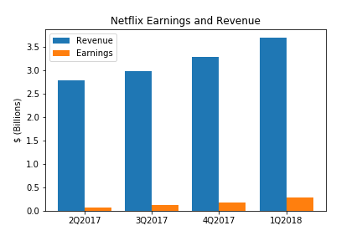
Netflix Earnings vs Revenue in 2017
Key Points-
Earnings averages around 5% of total revenue but this percentage has been increasing every quarter (Q1=2.3% - Q4=7.8%)
Both Earnings and Revenue are in an upward trend.
Although Earnings are significantly lower than Revenue they are growing at a faster rate and have grown more than 300% in 2017

Slide 5
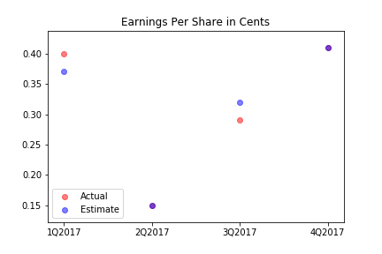
Netflix Estimated vs Actual Revenue in 2017
Key point- Estimated Revenue was generally accurate and was exactly in line with actual revenue in Q2 and Q4 (purple represents perfect match)

Slide 6
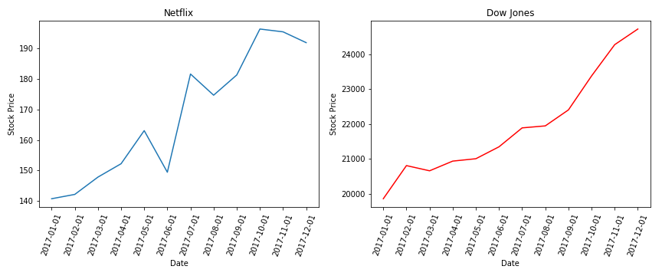
Netflix Stock vs DJI
Key Points-
Netflix was more profitable 1/1/17- 12/31/17 than the DJI
Netflix was more volatile than the DJI and despite a strong bullish trend had two clear pull backs in May and July

